Slide 1

TAGORE INSTITUTE OF ENGINEERING AND TECHNOLOGY
DEVIYAKURICHI
DEPARTMENT OF ARTIFICAL INTELLIGENCE AND DATA SCIENCE
(III-YEAR VI-SEMSTER)
Project Report
Energy consumption prediction using machine learning
P.Gayathri - 623022243017
R.Haripriya - 623022243021
K.Swetha - 623022243052
P.Prema - 623022243033

Slide 2

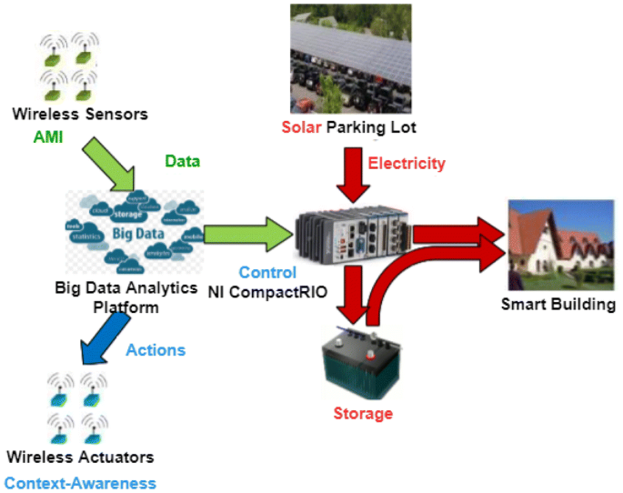

Energy consumption prediction using machine learning

Slide 3
Content
Abstract
Problem Statement
Objective
Data Collection and Preparation
Proposed Solution (Methodology)
Model Performance Evaluation
Screenshots / Demonstration (video)
Future Scope
Conclusion
Notes:
Abstract
Problem Statement (Clearly define the challenge)
Objective (State your project's goal)
Background and Research (Discuss existing solutions, trends, and gaps)
Data Collection and Preparation (Focus on data sources, cleaning, and augmentation)
Proposed Solution (Methodology)
Model Architecture (e.g., CNN, U-Net, YOLOv5)
Key Techniques (e.g., Transfer Learning, Image Augmentation)
Model Performance Evaluation
Metrics (Accuracy, Precision, Recall, IoU, etc.)
Graphs (Confusion Matrix, ROC Curve, etc.)
Screenshots / Demonstration (Visual proof of system functionality)
Future Scope (Improvements, scalability, and integration ideas)
Conclusion (Summarize results and impact)
Q&A Session

Slide 4
Abstract
Predicting energy consumption is essential for efficient energy management and smart grid development.
Traditional statistical methods are often limited in handling complex and nonlinear energy usage patterns.
Machine learning offers a more flexible and accurate approach to forecasting energy demand.
Various algorithms such as Linear Regression, Decision Trees, Support Vector Machines, and Neural Networks can be used for prediction.

Slide 5
Problem Statement
Energy consumption is increasing rapidly due to population growth and technological advancements.
Managing energy demand efficiently is becoming more difficult with traditional methods.
Accurate prediction of energy usage is critical for planning, distribution, and reducing energy waste.
Existing statistical models often fail to capture complex, non-linear patterns in consumption data.
These models may lack adaptability to changing weather, occupancy, and user behavior patterns

Slide 6
Objective
To develop accurate models for forecasting energy consumption using machine learning techniques.
To analyze historical energy usage data for identifying patterns and trends.
To apply machine learning algorithms to predict short-term and long-term energy demand.
To compare the performance of different machine learning models in terms of prediction accuracy.
To reduce errors and improve reliability in energy consumption forecasts.

Slide 7
Data Collection and Preparation
Collect historical energy consumption data from smart meters, sensors, or utility databases.
Gather additional relevant data such as weather conditions, temperature, humidity, and time-of-day.
Include occupancy data, appliance usage, and building characteristics if available.
Merge datasets from different sources to create a comprehensive dataset.
Handle missing or incomplete values using techniques like interpolation or imputation.

Slide 8
Proposed Solution (Methodology)
Apply machine learning algorithms to model energy consumption patterns based on historical data.
Choose suitable algorithms for prediction, such as Linear Regression, Decision Trees, Random Forest, Support Vector Machines, or Neural Networks.
Preprocess the data by normalizing, encoding categorical features, and handling missing values.
Select key features that influence energy consumption, like weather, time of day, and occupancy.
Train the selected machine learning models using the prepared dataset.

Slide 9
Model Performance Evaluation
Evaluate model accuracy using metrics such as Mean Absolute Error (MAE) to measure the average magnitude of errors.
Use Root Mean Squared Error (RMSE) to assess the model's prediction error by penalizing larger deviations more heavily.
Calculate R² score to determine how well the model explains the variance in energy consumption data.
Conduct cross-validation to ensure the model's robustness and prevent overfitting.
Compare the performance of different machine learning algorithms (e.g., Linear Regression, Decision Trees, Random Forests, Neural Networks).

Slide 10
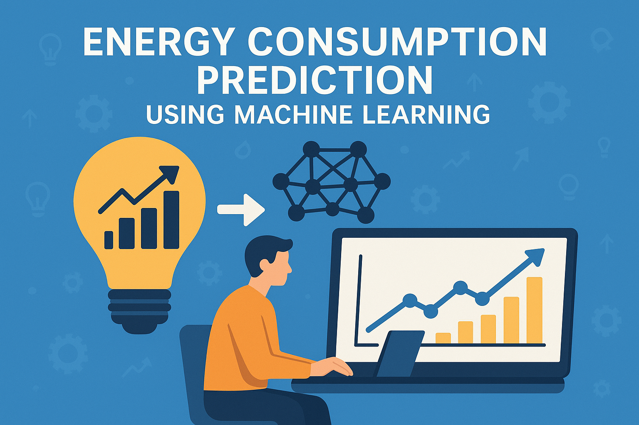
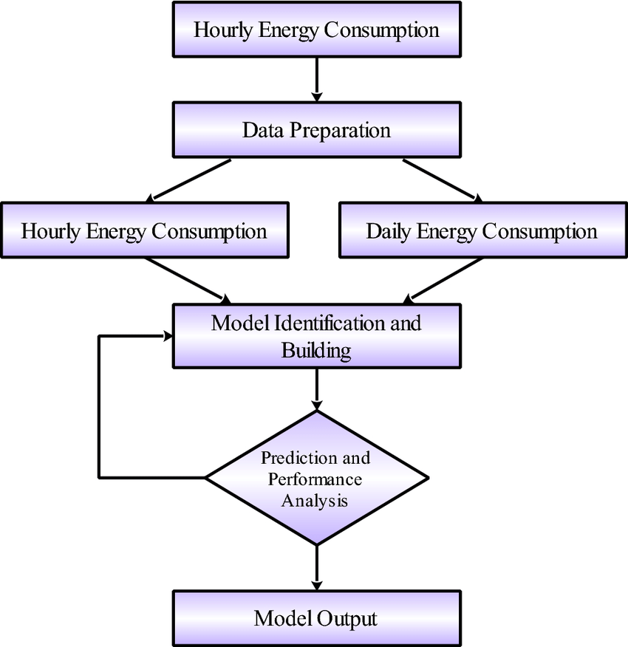
Screenshots / Demonstration (video)

Slide 11
Future Scope
Improved Forecast Accuracy: Advanced ML models like deep learning and ensemble methods can yield more precise energy demand predictions.
Integration with Smart Grids: Real-time prediction models will support dynamic load balancing and efficient grid management.
Scalability for Smart Cities: ML can optimize energy usage across interconnected systems like transportation, buildings, and public infrastructure.
Personalized Energy Recommendations: ML algorithms can analyze individual consumption patterns to suggest energy-saving actions.

Slide 12
Conclusion
Machine learning provides accurate and data-driven energy consumption forecasts.
It helps optimize energy usage across residential, commercial, and industrial sectors.
Real-time predictions enable better demand-side management and resource planning.
Integration with smart grids and IoT devices enhances automation and responsiveness.
ML models contribute to energy efficiency and environmental sustainability.

